Slide 1

PORTAL GAMES
SOFTWARE ARCHITECTURE AND PATTERNS
Luis Eduardo Barreto
Juan Sebastián Jaramillo Silva (jsjaramillos@academia.usbbog.edu.co)
Juan José Cuervo Higuera (jjcuervoh@academia.usbbog.edu.co)
Daniela Arenas Monroy (darenasm@academia.usbbog.edu.co)
San Buenaventura University

Slide 2
01
ANALYSIS
02
DESIGN
03
DEVELOPMENT
04
CONCLUSIONS

Slide 3
ANALYSIS
01
Business Logic
Logo
Company name
Problem description
Solution description
Stakeholders
Requirements list

Slide 4

BUSINESS LOGIC
LOGO
COMPANY NAME
PORTAL GAMES

Slide 5


PROBLEM DESCRIPTION
SOLUTION
DESCRIPTION

Slide 6

STAKEHOLDERS
GAMER COMMUNITY
VIDEOGAMES COMPANIES
MANAGER
UNIVERSITIES
DEVELOPERS
GOVERNMENT
CUSTOMERS

Slide 7
REQUERIMENT LIST
FUNCTIONAL
Code | Name
RF01 | Log in
RF02 | Register user
RF03 | Recover password
RF04 | Modify profile (User)
RF05 | Modify profile (Admin)
RF06 | Consult game in the store
RF07 | Buy game
RF08 | Reload coins
RF09 | Loading games into library
RF10 | Play game in library
RF11 | Game board
RF12 | View user statistics
RF13 | Rewards
RF14 | Send mail
RF15 | View game statistics
NO FUNCTIONAL
Code | Name
RNF01 | Graphic interface
RNF02 | Programming language
RNF03 | Development environment
RNF04 | Data persistence
RNF05 | Usability
RNF06 | Multimedia content

Slide 8

DESIGN
02
Mockups
Class diagram
Relational model
Architecture
Evaluation

Slide 9
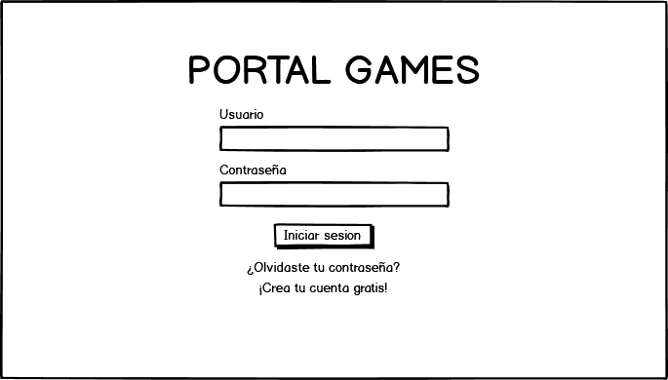
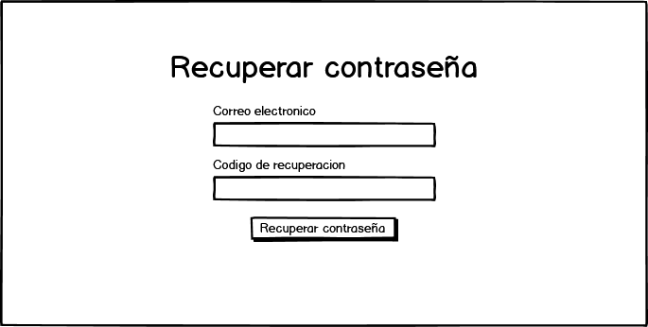
MOCKUPS
LOGIN
RECOVER PASSWORD

Slide 10
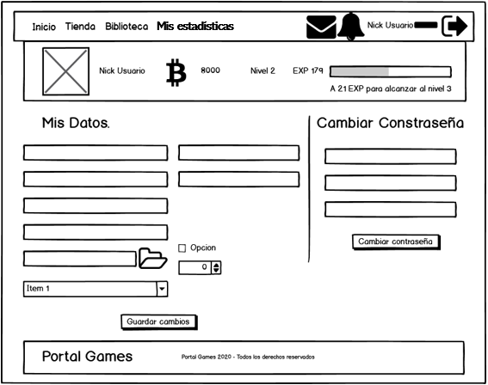
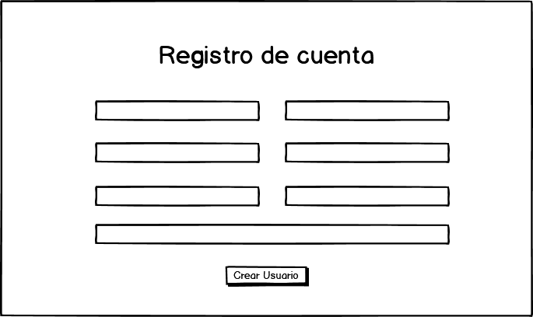
MOCKUPS
ACCOUNT REGISTRATION
HOMEPAGE

Slide 11
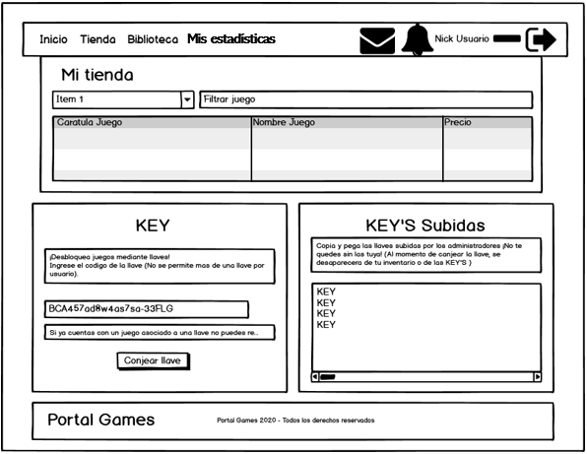
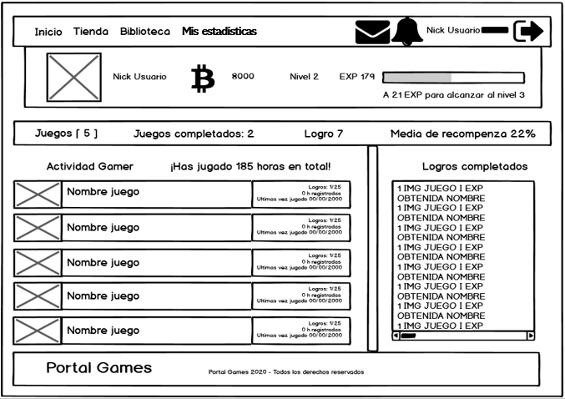
MOCKUPS
STORE
GAMES LIBRARY

Slide 12
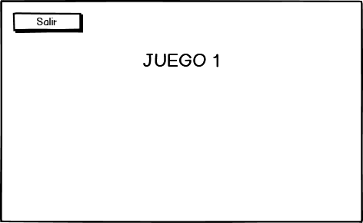
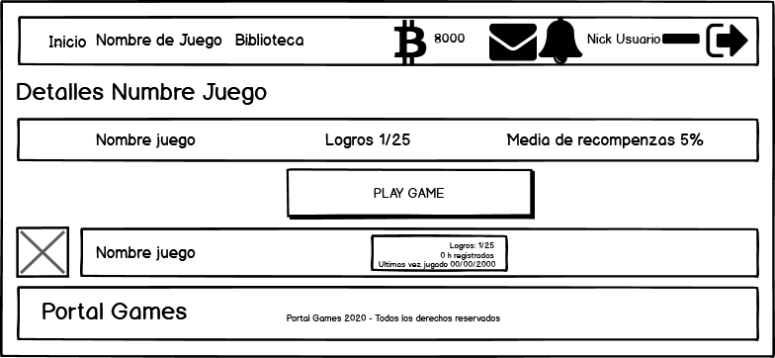
MOCKUPS
GAME DETAILS
GAME

Slide 13
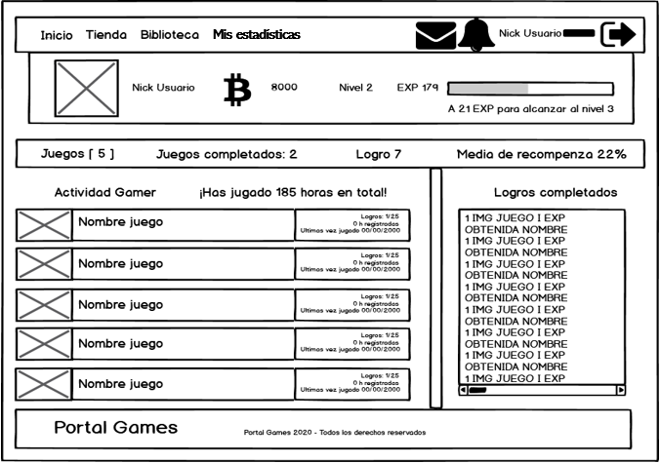
MOCKUPS
USER STATISTICS

Slide 14
CLASS DIAGRAM
https://github.com/Juancuervoh/PatronesDeSoftware/tree/master/DiagramDeClases

Slide 15
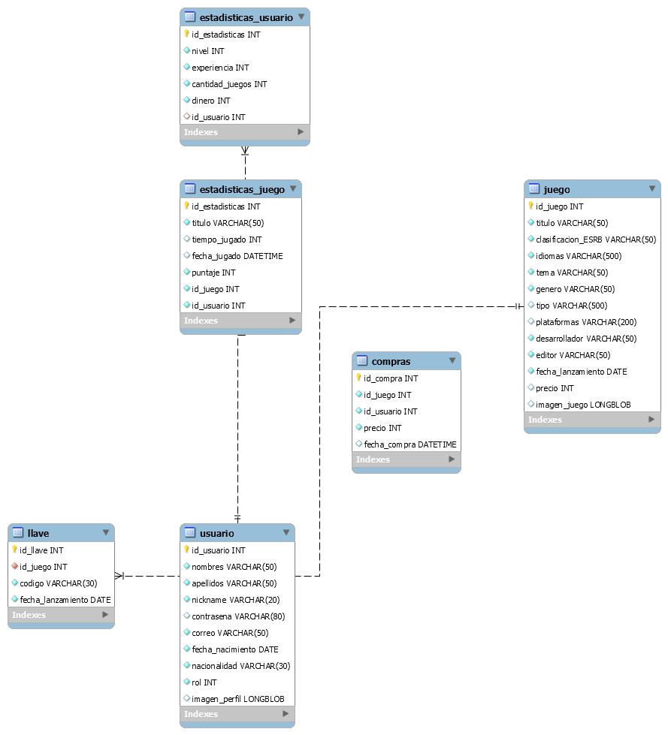
RELATIONAL MODEL

Slide 16
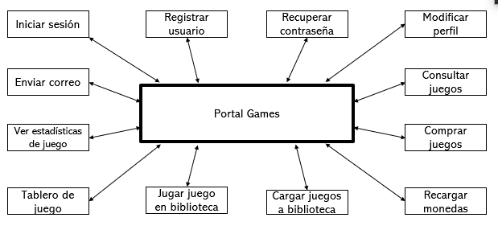
ARCHITECTURE
Version 1.

Slide 17
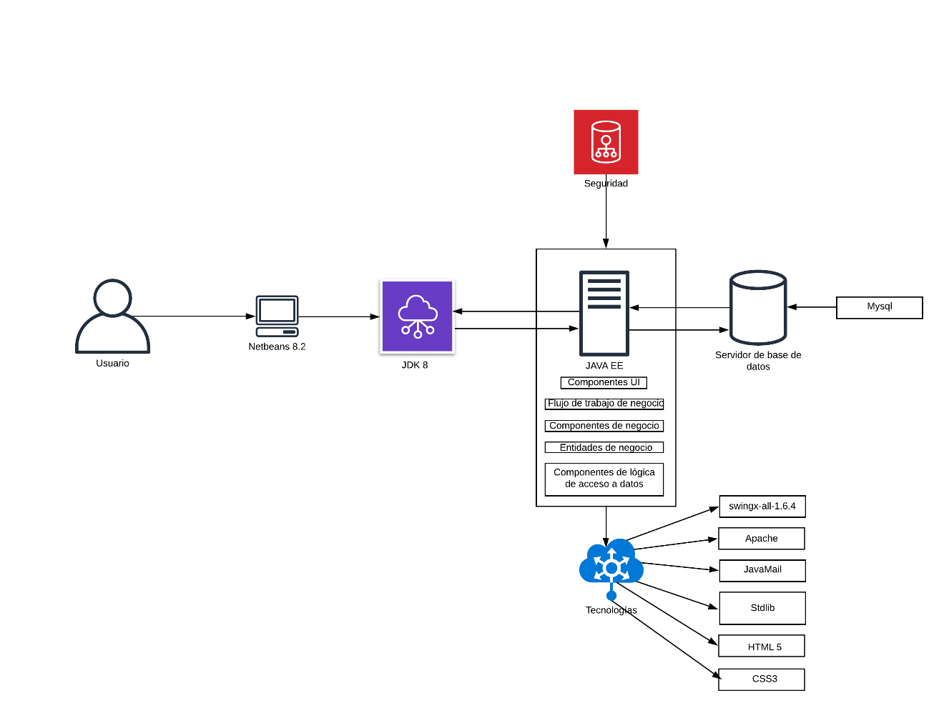
ARCHITECTURE
Version 2

Slide 18
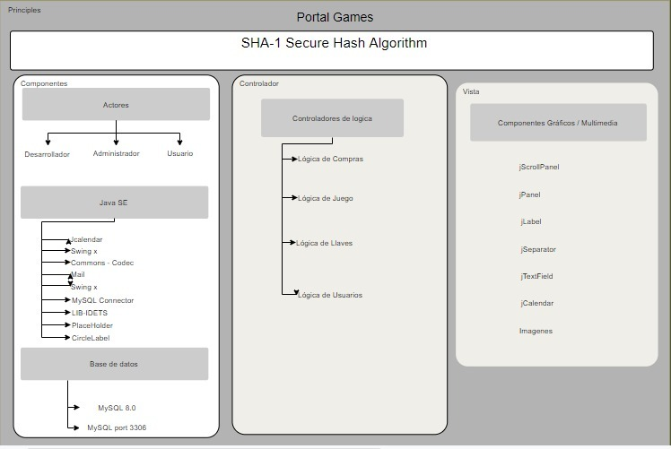
ARCHITECTURE
Version 3

Slide 19
EVALUATION
CRITERION | SCORE
Relevance
Effectiveness
Efficiency
Impact
Sustainability
Communication
Creativity
Design
Architectonic style
Functionality
CRITERION | SCORE
Relevance
Effectiveness
Efficiency
Impact
Sustainability
Communication
Creativity
Design
Architectonic style
Functionality
CRITERION | SCORE
Relevance
Effectiveness
Efficiency
Impact
Sustainability
Communication
Creativity
Design
Architectonic style
Functionality

Slide 20
DEVELOPMENT
03
Architecture patterns
SOLID principles
GoF desing patterns

Slide 21
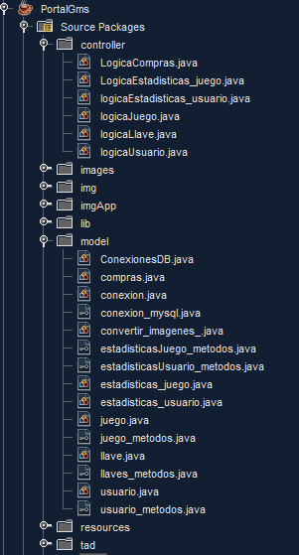
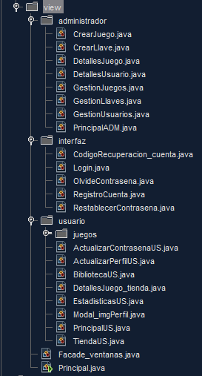

ARCHITECTURE PATTERNS
MVC

Slide 22

SOLID PRINCIPLES
SINGLE RESPONSABILITY PRINCIPLE

Slide 23

SOLID PRINCIPLES
OPEN CLOSE PRINCIPLE

Slide 24

SOLID PRINCIPLES
INTERFACE SEGREGATION PRINCIPLE

Slide 25
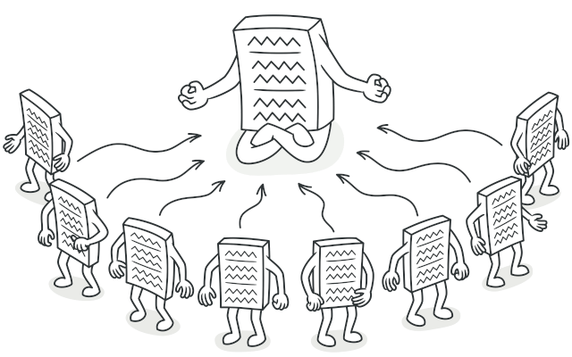
GoF DESING PATTERNS
CREATIONAL PATTERN
SINGLENTON

Slide 26

GoF DESING PATTERNS
CREATIONAL PATTERN
BUILDER

Slide 27

GoF DESING PATTERNS
STRUCTURAL PATTERN
FACADE

Slide 28

GoF DESING PATTERNS
BEHAVIOURAL PATTERN
Mediator
Observer
Visitor
Template methods
Chain of responsability

Slide 29

CONCLUSIONS
04

Slide 30
1
CONCLUSION
2
CONCLUSION
As learning, we highlight the creation of an architecture, the Gof patterns and the SOLID principles, since the use of these were the purpose of our project.
As future work we will possibly implement a "community" space, notifications and a local chat.

Slide 31
THANKS!

